Slide 1


NEXT GEN EMPLOYABILITY PROGRAM
CREATING A FUTURE-READY WORKFORCE
Student Name :
R.RAMYA SREE
Student ID :
College Name :
23KN1A0554
NRI INSTITUTE OF TECHNOLODY

Slide 2
CAPSTONE PROJECT SHOWCASE
Project Title
Online auction platform with React and ExpressJS Framework
Abstract | Problem Statement | Project Overview | Proposed Solution | Technology Used | Modelling & Results | Conclusion | Q&A

Slide 3
Abstract
1
An online auction is an auction which is held over the internet.
This application is used to sell the anything on the website from house.
2
It is a popular method for buying and selling products and services. Online Auction System helps to customer to sell
and buy product in best price
3
It is developed with the objective of making the system reliable, easier and fast. This application is used to sell the anything on the website from house
4

Slide 4


Problem Statement
This project focuses on developing a modern online auction platform using React for the frontend and Express.js for the backend, offering a seamless and real-time auction experience. The platform will allow sellers to list products and buyers to place bids, all while providing secure payments, user-friendly interfaces, and scalable performance.

Slide 5

Project Overview
1. MERN Stack: Built using MongoDB, Express.js, React.js, and Node.js.
2. Online Auction Platform: Allows users to create accounts, browse and bid on items.
3. User Authentication: Secure login and registration system.
4. Item Browsing: Users can browse items by category or search.
5. Bidding System: Users can place bids on items.
6. Auction Management: Users can create and manage their own auctions.
7. Payment Gateway: Integrates a secure payment gateway.

Slide 6
Proposed Solution
The proposed solution is to develop an online auction platform using the MERN (MongoDB, Express.js, React.js, Node.js) stack. The platform will allow users to create accounts, browse and bid on items, and manage their own auctions.
Core Features
User Management: Registration, login, and profiles.
Product Listing: Sellers list items with descriptions and images.
Auction Management: Multiple auction types with real-time updates.
Bidding System: Real-time bidding with notifications.
Secure Payment Processing: Integrated payment gateways.
Administrative Controls: User, auction, and transaction management.

Slide 7
Technology used
Frontend: React.js
Backend: Node.js with Express.js
Database: MongoDB
Real-time Updates: WebSockets

Slide 8
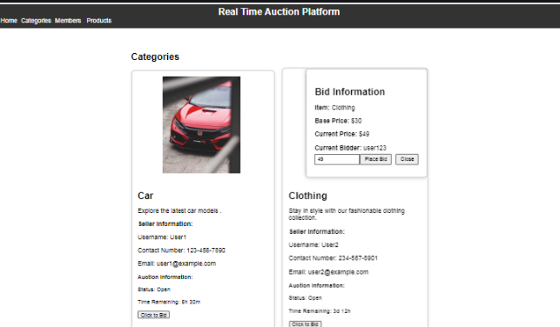
Modelling & Result

Slide 9
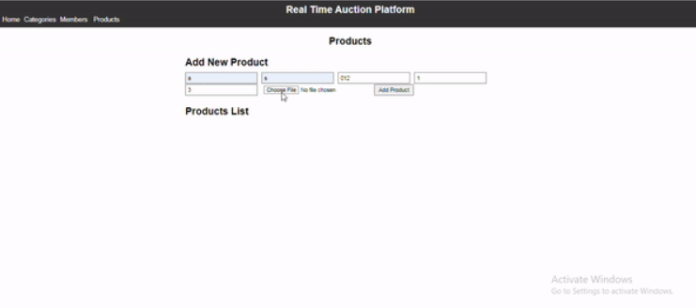
Modelling & Result

Slide 10
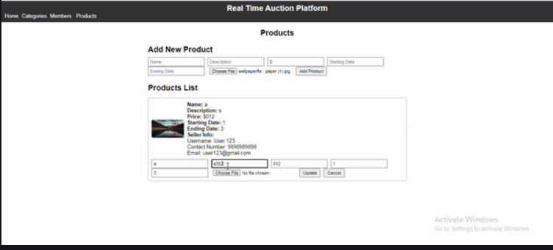
Modelling & Result

Slide 11

Conclusion
An Online Auction, excluding a Live Auction, will close at the end of the time period specified for that Online Auction, provided there are no new successful bids during the limited period immediately preceding the end of the time period specified. If there are any successful bids on a particular lot or item within that period of the time specified for the close of the Online Auction (the going, going, gone period), the auction will continue to be extended until there are no more within the Refresh Period. We accept no responsibility for any missed or unsuccessful bids resulting from any slight variations that may occur in the length of the Refresh Period.

Slide 12


Notes:
Thank You !!

